Slide 1
23CSE101 Computational Problem Solving
Academic Year: 2024-25 Odd
Batch: B.Tech CSE 2024-28
Course Administrivia

Slide 2
Faculty Details
Sl. No | Section | Faculty | Theory - Venue | Lab - Venue
1 | CSE A | Dr. Dhanya M. Dhanalakshmy | AB-III Second Floor C302 | AB-II Ground Floor Lab-II
2 | CSE B | Ms. Malathi P. | AB-III Second Floor C304 | AB-II First Floor Lab-III
3 | CSE C | Mr. Dayanand V. | AB-III Second Floor D301 | AB-II Ground Floor Lab-II
4 | CSE D | Dr. Guruprakash J. | AB-III Second Floor F301 | AB-II Ground Floor Lab-I
5 | CSE E | Dr. Govindarajan J. | AB-III Second Floor F303 | AB-II Ground Floor Lab-II
6 | CSE F | Dr. Dhanya M. Dhanalakshmy | AB-III Second Floor F305 | AB-II Ground Floor Lab-I
7 | CSE G | Dr. Anbazhagan M. | AB-I Third Floor C411 | AB-II Ground Floor Lab-I
8 | CSE H | Mr. V. Dayanand | AB-I Third Floor C412 | AB-II Ground Floor Lab-I

Slide 3
Course Objectives
The objective of this course is to introduce the computational aspects of problem-solving to the students. The course exposes computational thinking to the students through systematic treatment on algorithms, logical reasoning, and solutions. The course then introduces Python language, which will be used as a computational tool for both designing algorithms and solving problems.

Slide 4
Course Outcomes
CO1: Apply algorithmic thinking to understand, define and solve problems.
CO2: Design and implement algorithm(s) for a given problem.
CO3: Apply the basic programming constructs for developing solutions and programs.
CO4: Analyze an algorithm by tracing its computational states, identifying bugs and correcting them.

Slide 5
L-T-P-C and Evaluation Pattern
L-T-P: 3-0-2 (3 Theory slots + one 2-slot Lab session per week)
Credits: 4
Evaluation Pattern: 70:30
Internal: 70
Mid-Term: 20
CA-Theory: 10
CA-Laboratory: 40
External: 30

Slide 6
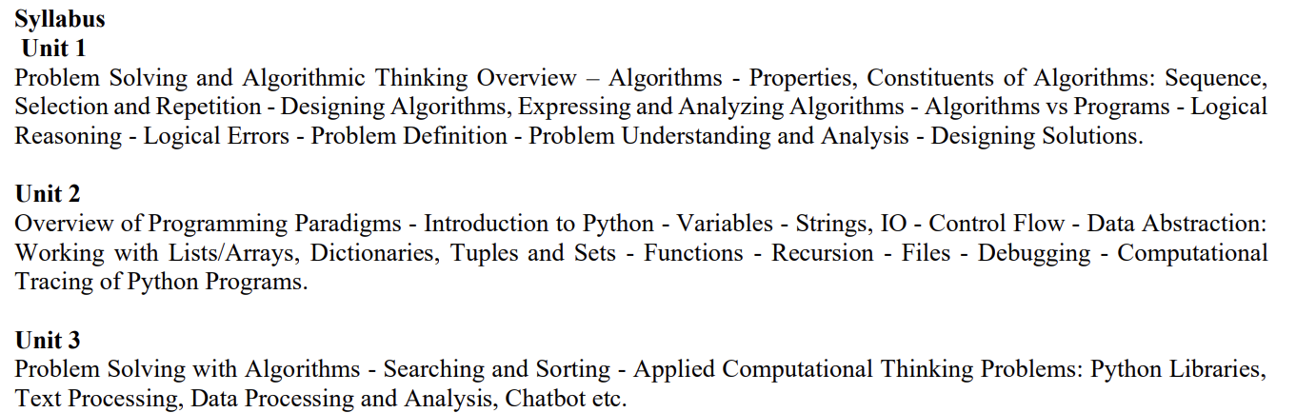
Syllabus

Slide 7




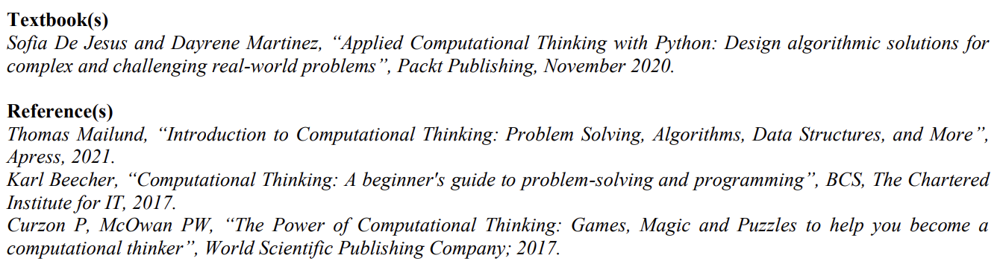
Textbooks & References

Slide 8
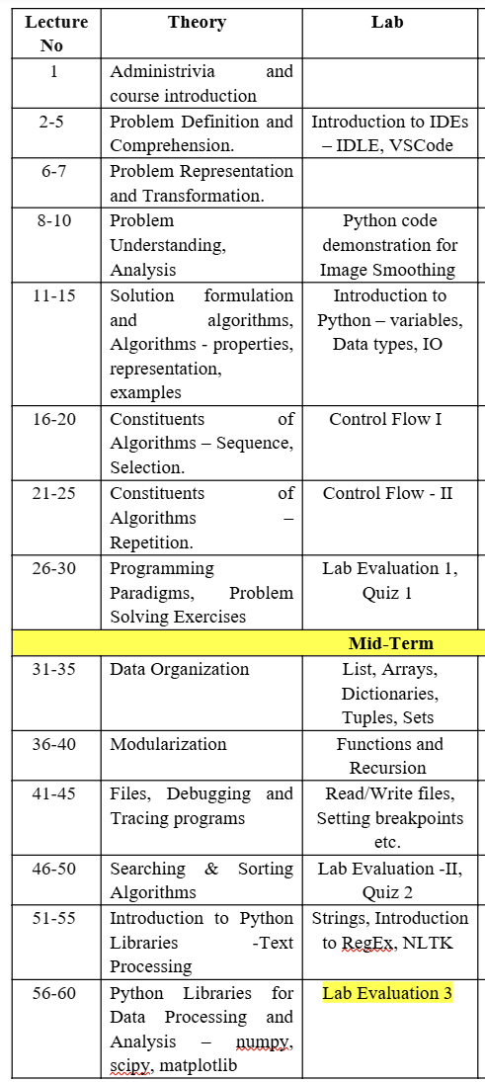
Course Plan

Slide 9
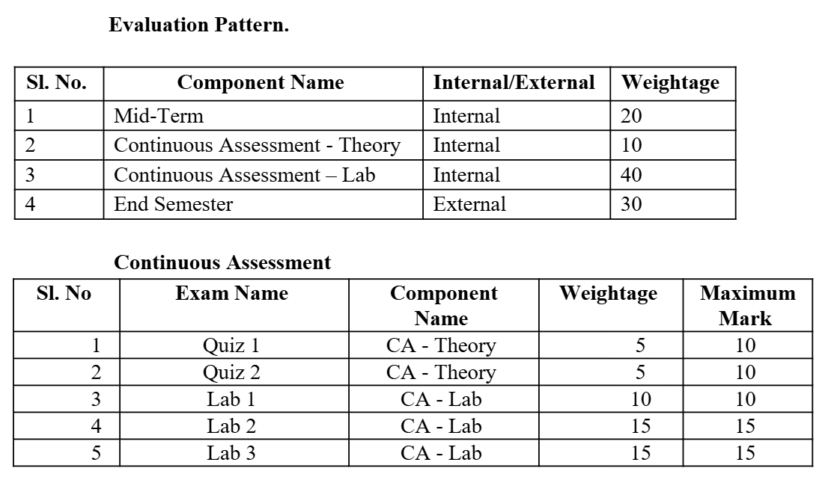
Evaluation Pattern and Plan

Slide 10
Tools to be used
For coding
IDLE
VSCode
For Tracing and Visualization
Python Tutor - Python Tutor code visualizer: Visualize code in Python, JavaScript, C, C++, and Java

Slide 11
Happy Learning ☺

Slide 12
Let’s hear a story !!!
Strange complaint @ Pontiac Division of General Motors
My car won't start after I buy a Vanilla Ice cream
Correlation does not mean causation
Credits:https://wallhere.com/en/wallpaper/748460

